Slide 1





In association with Dept of CSE
wHACKiest'24
MedTech
Nationwide Health Record Management System
Electron Proton Neutron
Ananya Mehrotra(1MS24CS018-T)
Maurya Doshi(1MS24CS113-T)
Sunidhi Shree(1MS24CS010-T)
wHACKiest </2024>

Slide 2


Problem Statement
The healthcare system of India faces significant challenges due to fragmented patient records across multiple hospitals, clinics, and labs. This leads to:
Medical errors due to lack of access to previous health records, including allergies, pre-existing conditions, implants (e.g., metal rods), and prior treatments.
Difficulty managing chronic diseases or emergencies where immediate access to medical history is critical.
A unified system leveraging Aadhaar or biometric access is needed for efficient diagnosis and treatment.
wHACKiest </2024>

Slide 3


Proposed Idea
Develop a Nationwide Digital Health Record System that integrates with Aadhaar and biometrics for secure and real-time access to comprehensive patient records. Key features:
Centralized Database: A secure cloud database that stores patient records and medical history accessible across hospitals.
Biometric and Aadhaar Integration: Authentication via Aadhaar-linked biometrics.
Doctor and Patient-Only Access: Role-based access for authorized healthcare professionals, ensuring privacy and security.
Emergency Contacts: Stores the contact information of the kin or spouse of the patient to grant them access if the patient is unresponsive.
Inter-operability: Integration with existing hospital systems, ensuring smooth data sharing.
wHACKiest </2024>

Slide 4
TECH STACK
Backend:
Java: For core backend logic, APIs, and business logic.
Python (Flask): For building APIs and microservices.
SQL: For managing the database operations.
Beautiful Soup: For web scraping tasks if required.
Frontend:
HTML/CSS: For building the structure and styling of the user interface.
JavaScript: For dynamic client-side functionalities.
Additional:
Java: For any performance-critical tasks.
Node.js: (not strictly in this tech stack but can be integrated for certain frontend/backend needs).
wHACKiest </2024>

Slide 5
FlowChart
User Access: A doctor logs into the system via Aadhaar or biometric authentication on the website along with their unique hospital code.
Authentication: Aadhaar API or biometric service validates the user's identity.
Data Request and Processing:
The system queries the database for the patient's health records. Relevant patient history is retrieved, encrypted/decrypted using Java/Python.
Response to Frontend: The processed data is sent to the user interface for the doctor to review.
Update Records: Any new diagnosis or treatment is securely added to the database via the same flow.
wHACKiest </2024>

Slide 6
Conclusion
The implementation of a nationwide digital health database accessible via Aadhaar or biometric authentication will streamline healthcare delivery, enhance patient safety, and improve the quality of care. It will enable healthcare providers to access comprehensive patient records in real time, reducing redundant procedures and helping to provide accurate information and treatment.
The centralized database system ensures security, privacy, and compliance with healthcare regulations, ultimately leading to better patient outcomes and reduced healthcare costs.
wHACKiest </2024>

Slide 7
Why this Idea?
Inaccurate healthcare leads to more deaths than insufficient access to healthcare-1.6 million Indians died due to mistreatment in 2016, nearly twice as many as due to non-utilization of healthcare services (838,000 persons).
However, this can be avoided if we have such a database that can immediately and accurately access the records and medical history of the patient recognizing how to treat their condition accordingly.
This idea will also help in:
Improved Patient Safety: Ensures accurate treatment through access to comprehensive medical history.
Cost Reduction: Streamlines administrative processes and reduces healthcare costs.
Enhanced Coordination: Facilitates better collaboration among healthcare providers across different facilities.
Accessibility: Patients and doctors can access health records anytime and from anywhere, promoting continuity of care.
Security and Privacy: Utilizes Aadhaar for authentication, ensuring data security and patient privacy.
wHACKiest </2024>

Slide 8
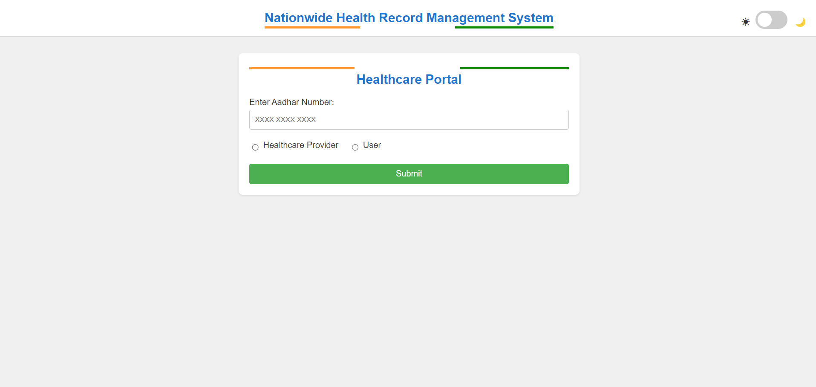
SNAPSHOTS
wHACKiest </2024>

Slide 9
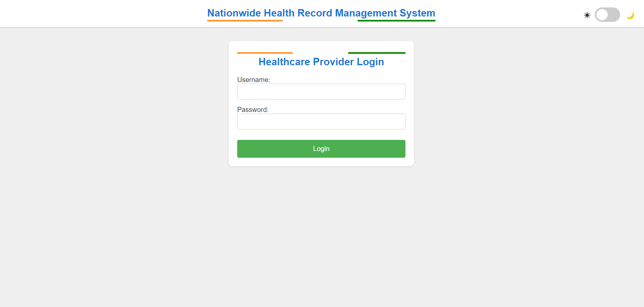
SNAPSHOTS
wHACKiest </2024>

Slide 10
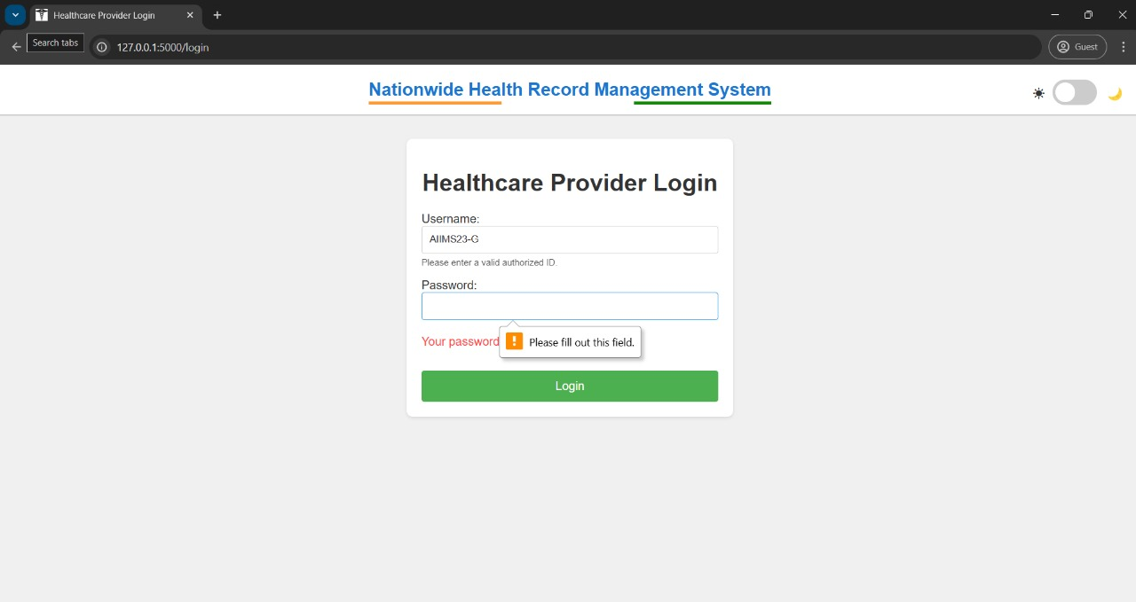
SNAPSHOTS
wHACKiest </2024>

Slide 11
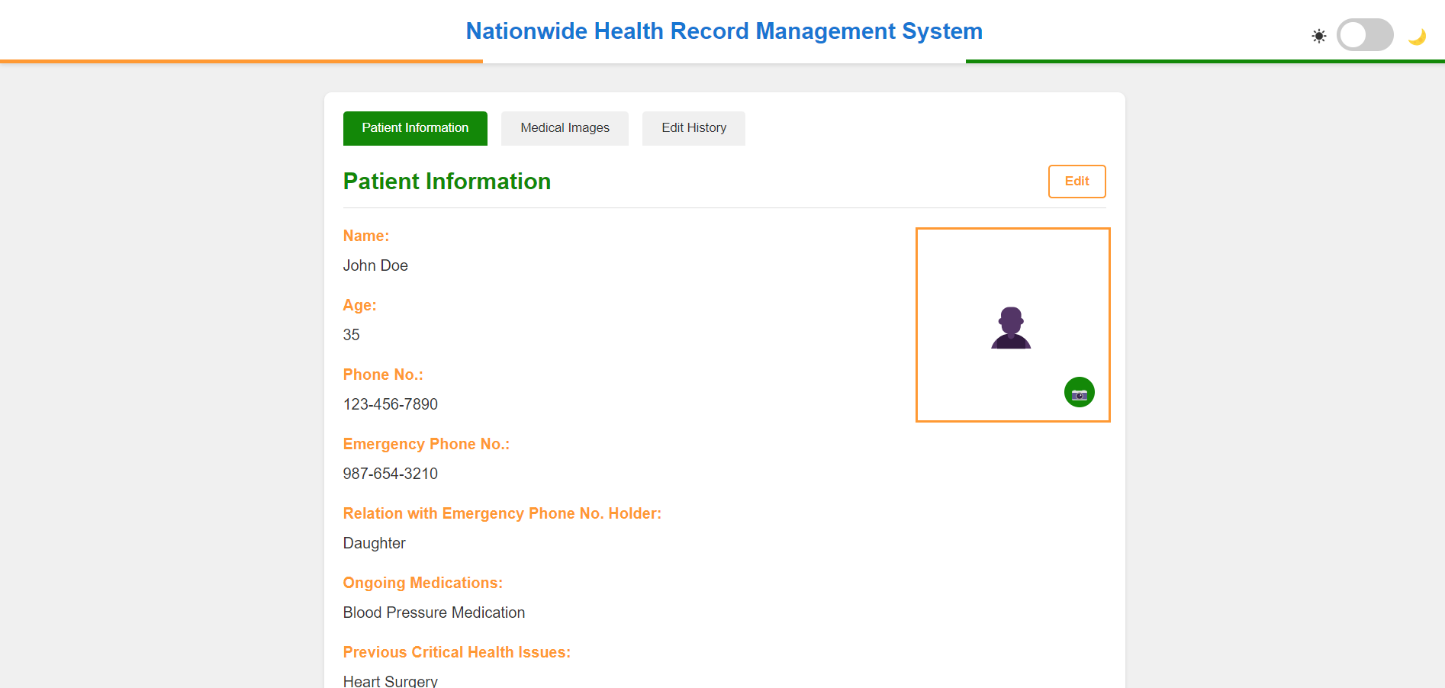
SNAPSHOTS
wHACKiest </2024>

Slide 12
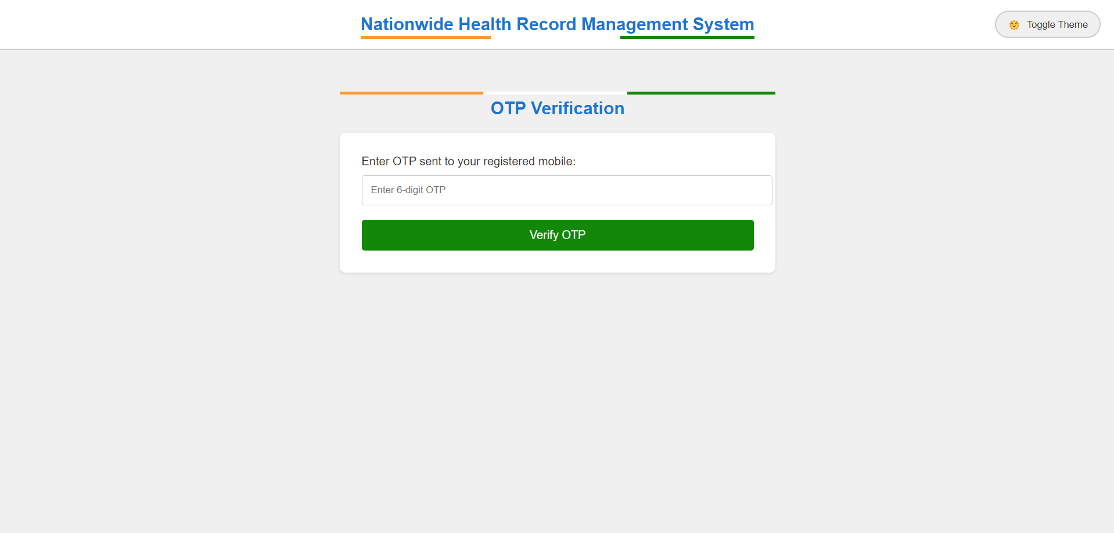
SNAPSHOTS
wHACKiest </2024>

Slide 13
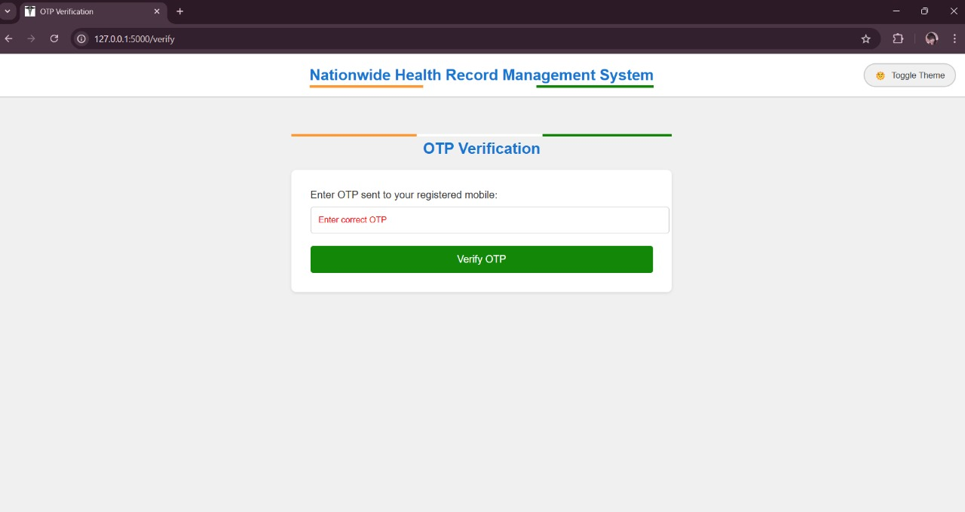
SNAPSHOTS
wHACKiest </2024>

Slide 14
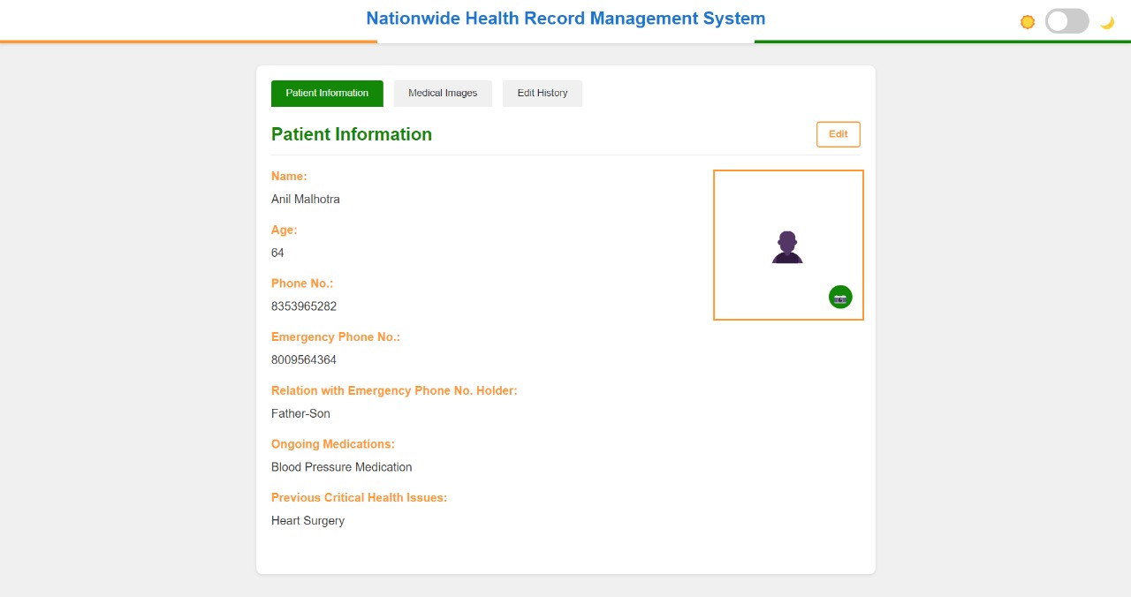
SNAPSHOTS
wHACKiest </2024>

Slide 15
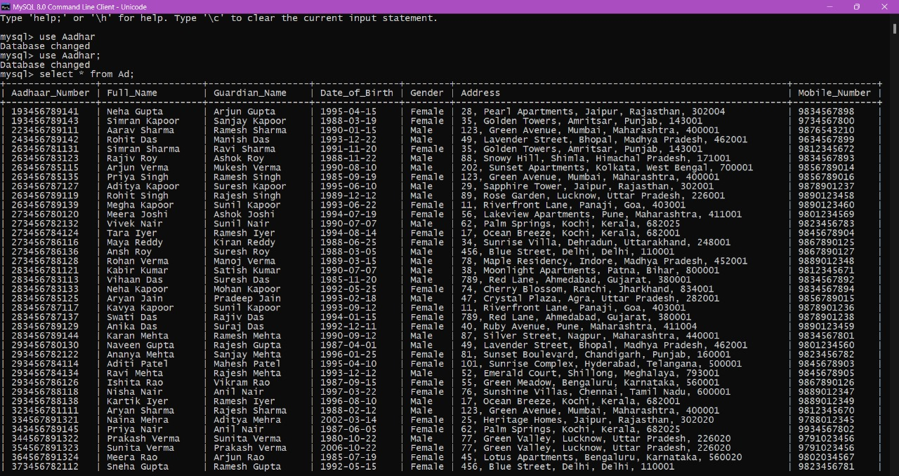
SNAPSHOTS
wHACKiest </2024>

Slide 16
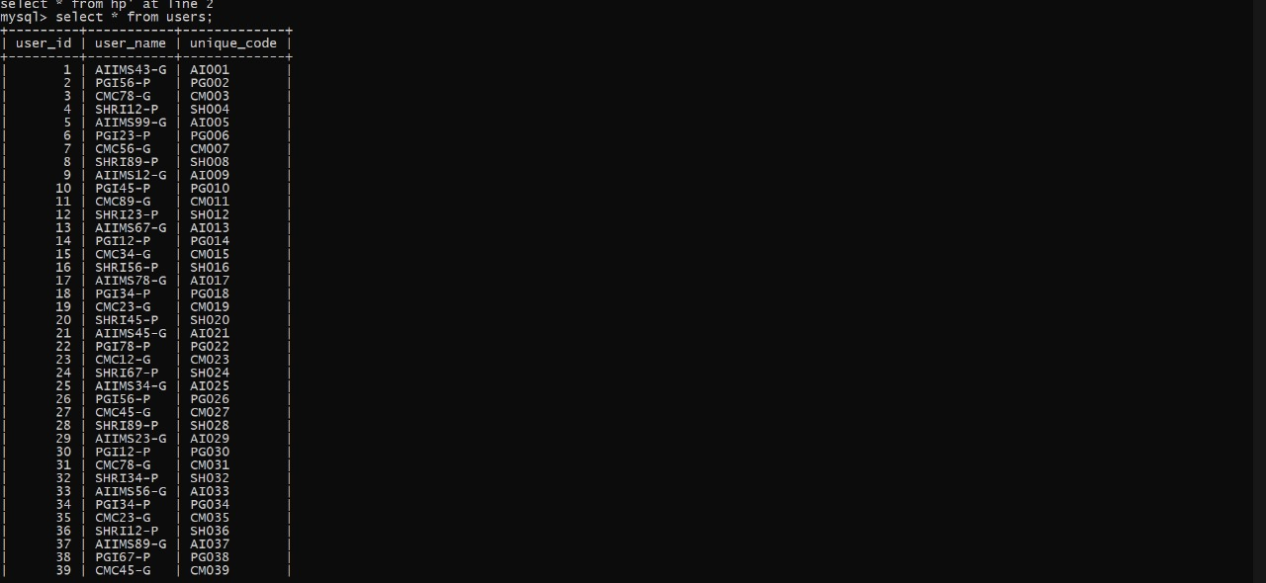
SNAPSHOTS
wHACKiest </2024>

Slide 17
Implemented features
Users can access only by OTP
Implemented read and write for healthcare providers, and read only for users
Added a Python backend that checks a SQL database when Aadhar number is entered
Dark and light mode toggle
Implemented a favicon
Created a calendar that creates events with titles and time reminders when clicked on desired date for scheduling appointments
Healthcare providers can see, edit and add patient information as well as the prescriptions
Medical scans and health reports can be uploaded by healthcare provider
Added edit history showing the time and date of the edit in healthcare provider dashboard
wHACKiest </2024>

Slide 18
Video link
https://youtu.be/QD9o0eRVvQM
wHACKiest </2024>

Slide 19
THANK YOU!
wHACKiest </2024>

